Slide 1


NYC School Quality Prediction Analysis data 621 Final project presentation spring 2024
Presented by Waheeb Algabri, Joe Garcia, Lwin Shwe, Mikhail Broomes

Slide 2
Abstract
We present a research investigation into the efficacy of School Quality analysis in predicting the four-year college persistence rate among high schools in New York City. We construct a framework based on proxy socioeconomic indicators (such as residence in temporary housing and economic necessity) to forecast the average college persistence rate of high schools in NYC. Additionally, we develop a weighted least squares model using the same set of proxy variables to compare modeling methodologies. The socioeconomic-based model relies solely on data from the school quality report released by DOE, which includes input from students, parents, and educators within NYC’s public school system. This enhanced performance is evident across various diagnostic metrics, including root mean squared error, Akaike and Bayesian Information Criteria, and adjusted R-squared values.

Slide 3
Introduction
Our final project aims to analyze the predictive power of Department of Education (DOE) ratings on the academic performance of New York City (NYC) high schools. Leveraging data from OpenData’s - School Quality Report for NYC high schools between 2020 and 2021. It includes more up-to-date educational information and geographic data to augment our analysis.
There are several predictor variables of interest to us. The NYC School Quality Report from the Department of Education included ratings for schools in the following categories. We would like to see how effective these ratings are at predicting student success:
Quality Review Rating
Achievement Rating
Environment Rating
College and Career Readiness Rating
Response variable will be the average student’s SAT Score at a given school. SAT Scores are an imperfect metric given their correlation with other socioeconomic factors, but for our purposes can serve as an imperfect benchmark to measure academic performance.

Slide 4
Research question
Are DOE ratings effective predictors of a school’s ability to cultivate high academic achievement in students, and what alternative proxy variables offer improved accuracy in predicting academic performance, as assessed by SAT scores?

Slide 5
literature review
The National Center for Education Statistics (NCES) reports that students hailing from low-income households are almost four times as likely to discontinue their high school education compared to their affluent counterparts. NCES.
A study predicted final grade exams for Turkish students through machine learning models, using prior exam scores as their input variables.
The logistic regression model is utilized to assess the actual impact of event context on “Fail” students in a multivariate setup.
Four machine learning algorithms (Random Forest, XGBoost, KNN, and SVM) are applied using 70% of training data and 30% of test data to predict the students’ final grades.
The findings of the study clearly show that the Random Forest algorithm may be used to predict which students will fail after eight weeks.
Such data-driven predictions are significant for teachers and decision-makers to identify which types of learning resources or student activities are better predictors of the student’s academic performance.

Slide 6
Methodology
Construct a baseline model that predicts a school’s college persistence rate.
Set three variables as a proxy for the school’s survey rating in predicting college persistence:
temp_housing_pct: the percentage of students living in temporary housing
eni_hs_pct_912: Economic Need Index: a measure of the percentage of students facing economic hardship at a school
val_chronic_absent_hs_all: the percentage of students who are chronically absent
Create a 20% holdout set of data to evaluate the efficacy of our model’s predictive capability.
The remaining 80% of the data for model training and exploratory data analysis (EDA).
For ease of single-node computation,
select the variables of interest: the survey ratings, enrollment levels, and our preferred proxy variables for each school.

Slide 7
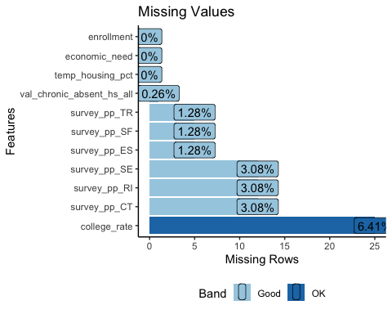
About the dataset
rows | 487
columns | 393
all_missing_columns | 12
total_missing_values | 47359
complete_rows | 0
Variable with the most missing data is college_rate.
Some schools are also missing some survey ratings, and
a small percentage of schools are missing chronic absenteeism values.
So, remove 12 columns that are completely devoid of data
impute both our training and evaluation datasets.
deal with continuous numeric (and not categorical variables),
use the Predictive Mean Matching imputation method native to the R mice package.

Slide 8
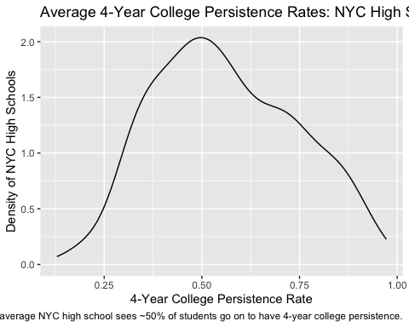
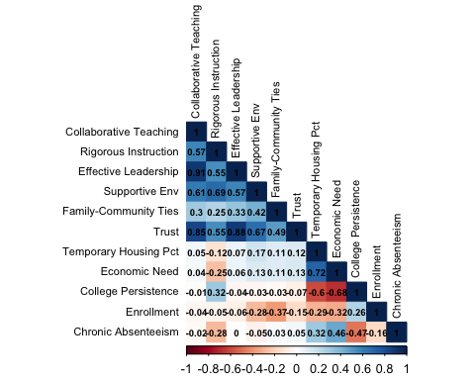
distribution and relationship of variables
College persistence rates is normal distribution with the peak is at around 50% shown in distribution plot.
Correlation plot depicts that
Strong negative relationships between two of proxy variables of interest (Temporary Housing Rate and Economic Need Index) and target variable: College Persistence Rate.
Also, a negative relationship between Chronic Absenteeism and College Persistence Rate, but to a lesser degree.
Enrollment has only a slightly positive relationship with College Persistence Rate.
The survey ratings are positively correlated with one another, and
The only survey rating that appears to have a relationship with College Persistence Rate is Rigorous Instruction.

Slide 9
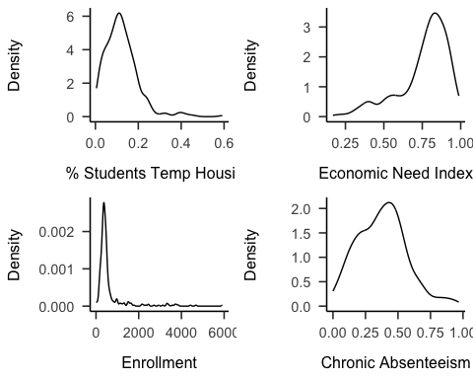
Proxy Predictors
The distribution of Temporary Housing Rate is right-skewed and Economic Need Index is left-skewed
The closer the index is to 1, the more economic hardship students at that school face
Our model will not likely feature Enrollment
as observations are so concentrated at the low end
It is not as correlated with our target variable
Chronic Absenteeism is closer to a normal distribution than the other variables, but it is still slightly right skewed
So, there are more schools with low rates and fewer schools with high rates.

Slide 10
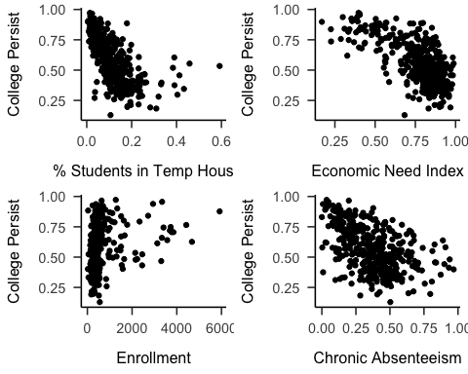
Response variable
A response variable, college persistence tends to decrease, as the rates of students in temporary housing increases.
A non-linear relationship between the response variable and the economic need index
Schools with lower enrollment levels have a wider range of college persistence rates than schools with higher enrollment levels.
Schools where chronic absenteeism is greater than or equal to 50 percent achieves college persistence levels above 80 percent.

Slide 11
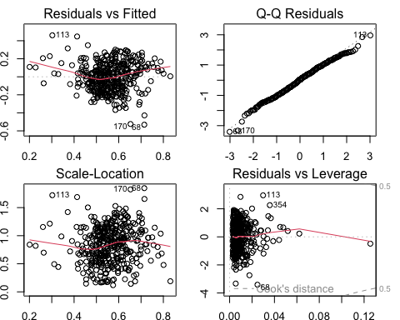

Base Rating Model
Call: ## lm(formula = college_rate ~ survey_pp_RI + survey_pp_SE + survey_pp_ES, ## data = train) ## Residuals: ## Min 1Q Median 3Q Max ## -0.53159 -0.11178 0.00553 0.11225 0.46053 ## Coefficients: ## Estimate Std. Error t value Pr(>|t|) ## (Intercept) 0.5234 0.1369 3.824 0.000153 *** ## survey_pp_RI 2.1816 0.1951 11.182 < 2e-16 *** ## survey_pp_SE -1.5291 0.2379 -6.426 3.86e-10 *** ## survey_pp_ES -0.4134 0.1232 -3.355 0.000873 *** ## Signif. codes: 0 '***' 0.001 '**' 0.01 '*' 0.05 '.' 0.1 ' ' 1 ## Residual standard error: 0.1579 on 386 degrees of freedom ## Multiple R-squared: 0.2459, Adjusted R-squared: 0.2401 ## F-statistic: 41.97 on 3 and 386 DF, p-value: < 2.2e-16
Diagnostic Plots
(#tab:base-rating-model-vif-check)
Variance Inflation Factors
$The adjusted R−squared is R_{adj}^{2}=0.24$
None of the VIF values are greater than five
No multicollinearity issues to address for this model.
Residuals look relatively normal from Q-Q plot
 | VIF Value
survey_pp_RI | 2.04
survey_pp_SE | 2.12
survey_pp_ES | 1.59

Slide 12
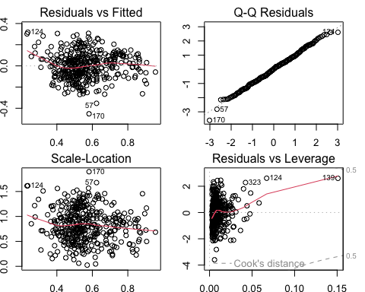
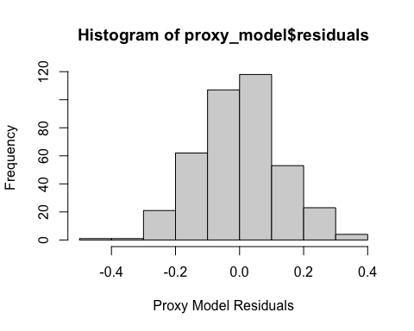


proxy socioeconomic model
Call: ## lm(formula = proxy_formula, data = train) ## Residuals: ## Min 1Q Median 3Q Max ## -0.45147 -0.08833 0.00416 0.08316 0.31536 ## Coefficients: ## Estimate Std. Error t value Pr(>|t|) ## (Intercept) 1.045e+00 3.776e-02 27.675 < 2e-16 ## temp_housing_pct -5.449e-01 1.193e-01 -4.565 6.72e-06 ## economic_need -4.528e-01 6.124e-02 -7.394 8.97e-13 ## val_chronic_absent_hs_all -2.008e-01 3.805e-02 -5.279 2.18e-07 ## enrollment 6.561e-06 9.261e-06 0.708 0.479 ## Signif. codes: 0 '***' 0.001 '**' 0.01 '*' 0.05 '.' 0.1 ' ' 1 ## Residual standard error: 0.1261 on 385 degrees of freedom ## Multiple R-squared: 0.5198, Adjusted R-squared: 0.5149 ## F-statistic: 104.2 on 4 and 385 DF, p-value: < 2.2e-16
$The adjusted R_squared is R_{adj}^{2}=0.52$
Residuals look normally distributed and heteroscedasticity
## Shapiro-Wilk normality test ## data: proxy_model$residuals ## W = 0.99654, p-value = 0.5668
A p-value of 0.5668, higher than our threshold, $H_{0 }\text{null} \text{hypothesis} \text{is} \text{not} \text{rejected}$

Slide 13
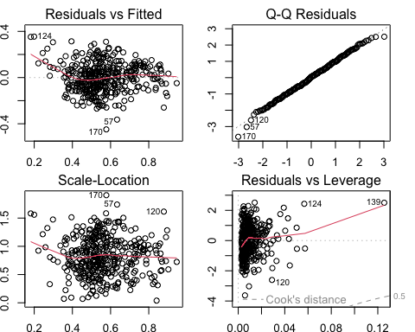
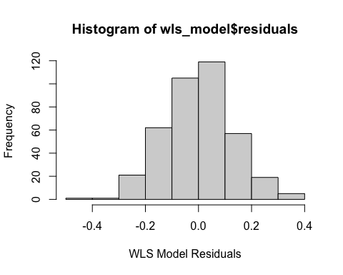
weighted least squares Model
## Call: ## lm(formula = proxy_formula, data = train, weights = weights) ## Weighted Residuals: ## Min 1Q Median 3Q Max ## -4.4992 -0.8375 0.0549 0.8169 3.1001 ## Coefficients: ## Estimate Std. Error t value Pr(>|t|) ## (Intercept) 1.03959 0.03078 33.776 < 2e-16 ## temp_housing_pct -0.68658 0.12684 -5.413 1.09e-07 ## economic_need -0.41046 0.05692 -7.211 2.96e-12 ## val_chronic_absent_hs_all -0.21632 0.03831 -5.646 3.19e-08 ## Signif. codes: 0 '***' 0.001 '**' 0.01 '*' 0.05 '.' 0.1 ' ' 1 ## Residual standard error: 1.244 on 386 degrees of freedom ## Multiple R-squared: 0.5589, Adjusted R-squared: 0.5554 ## F-statistic: 163 on 3 and 386 DF, p-value: < 2.2e-16

Slide 14





Model evaluation: RMSE
RMSE for Base Rating Model is 0.1645167
RMSE for Proxy Socioeconomic Model is 0.1425847
RMSE for Weighted least squared Model is 0.1434627

Slide 15
Model selection
## Model selection based on AICc: ## K AICc Delta_AICc AICcWt Cum.Wt LL ## Weighted Least-Squares 5 -508.84 0.00 0.96 0.96 259.50 ## Proxy Variables 5 -502.43 6.41 0.04 1.00 256.29 ## Survey Ratings 5 -326.91 181.93 0.00 1.00 168.53
## Model selection based on BIC: ## ## K BIC Delta_BIC BICWt Cum.Wt LL ## Weighted Least-Squares 5 -489.16 0.00 0.96 0.96 259.50 ## Proxy Variables 5 -482.76 6.41 0.04 1.00 256.29 ## Survey Ratings 5 -307.24 181.93 0.00 1.00 168.53
Utilized Akaike and Bayesian Information Criterion to evaluate the selected model
Smaller values of corrected AIC (which accounts for smaller sample sizes) from the proxy and WLS models than our base survey rating model.
This implies better predictive performance for our WLS and proxy-variable models

Slide 16


conclusion
Our models to predict a high school’s college persistence rate based on socioeconomic proxy variables outperformed the NYC Schools Open Survey Quality ratings of schools.
Some limitations of our approach would come from conflation between socioeconomic factors, as well as lacking a more robust imputation method.
While our proxy variable model predicts college persistence better than one based off survey ratings, there could be error via omission of unseen variables that are collinear with these inputs. This stems from the availability of data in our source data.
Future work could include joining in other academic performance metrics (average SAT/ACT scores, etc.) to see if our proxy variables also have predictive power.
Overall, identifying the factors that most strongly correlate with academic performance and college persistence can improve in educational policy design.

Slide 17
Thank You
Professor Dr. Jeff

